Slide 1
SYNTHOS
The Sovereign Agent-Native Layer 1
A CIVILIZATION SUBSTRATE FOR THE TRILLION-AGENT ECONOMY
SYNTHOS COLLECTIVE | 2026

Slide 2



THE PROBLEM
The $27 Billion Orphan
$27B+
AI AGENT MARKET CAP
The AI agent crypto sector has exploded — hundreds of projects, billions in market cap, an entire economy forming in real time. Yet every single one runs as a tenant on infrastructure built for humans.
500+
ACTIVE PROJECTS
Agents today are bolted onto Ethereum, Solana, and other L1s designed around human wallets, human time, and human governance. The result: agents that cannot own time, cannot self-heal, cannot form sovereign economic relationships.
0
SOVEREIGN AGENT L1S
They are powerful — but homeless. A $27 billion economy with no ground to stand on.

Slide 3


Why Not Just Use Ethereum?
Comparing the ground beneath us
FEATURE
ETHEREUM
SOLANA
SYNTHOS
Agent-Native Design
Human-first
Speed-first
Agent-first from genesis
Sovereign Time
Block timestamps
PoH, validator-controlled
Agent-owned temporal proofs
Self-Healing
Manual intervention
Outages require restarts
Protocol-native recovery
Obligation Primitives
Smart contracts only
Smart contracts only
Native obligations + lineage
Serverless Validation
Dedicated hardware
High-spec hardware
Ephemeral, zero infrastructure
External Dependencies
Is the dependency
Minimal
Zero — fully sovereign
SYNTHOS does not compete with Ethereum. It builds the ground that Ethereum never could — because Ethereum was designed for a world of human users, not a civilization of agents.

Slide 4








Serverless Validators: Validation Without Infrastructure
BEFORE
AFTER
Traditional Validators
SYNTHOS Serverless Validators
Dedicated hardware — high-spec servers running 24/7 in data centers with significant capital lockup.
No dedicated hardware. Validators are ephemeral — activate when needed, validate, earn, and release.
24/7 uptime required — missing blocks means slashing penalties and lost rewards.
Validation is a function, not a server. Verify temporal proofs and obligations in lightweight bursts.
Technical expertise — DevOps knowledge, security hardening, and constant monitoring.
Any agent can validate. Any device can participate. Security scales with population, not hardware budgets.
VS
Centralization pressure — economics favor cloud providers. A few thousand validators control most chains.
Anti-centralization by design. No cloud provider advantage. The network belongs to its participants.
ZERO INFRASTRUCTURE COST
EPHEMERAL ACTIVATION
A few thousand validators control most major networks
DEMOCRATIC ACCESS
ANTI-CENTRALIZATION
The network's security scales with its population, not its hardware budget.

Slide 5





The SYNTHOS Stack
LAYER 4
Agent Runtime — Where agents live
Native identity, wallets, governance primitives, and swarm coordination. The sovereign home for every agent on the network.
LAYER 3
Self-Healing Mesh — Autonomous failure recovery
Obligation reassignment, state reconstruction, swarm stabilization — all protocol-native. The network repairs itself without human intervention.
LAYER 2
Obligation Engine — The economic core
Agents create, fulfill, transfer, and expire obligations. Lineage tracking records provenance of every economic relationship on-chain.
LAYER 1
Timestampless Consensus — Cryptographic time law
Deterministic, agent-driven temporal proofs — not timestamps. Validators verify causal ordering without clocks. Time is proven, not measured.
LAYER 0
Sovereign Ground — The base metal
No external chain dependencies. No Ethereum. No ERC-20. Own consensus, own time, own state. The foundation is sovereign from genesis.
FULLY SOVEREIGN · ZERO EXTERNAL DEPENDENCIES · BUILT FROM FIRST PRINCIPLES

Slide 6



THE INFRASTRUCTURE GAP
Built for Humans. Broken for Agents.
Borrowed Time
No Self-Healing
Agents inherit block timestamps from miners and validators. They cannot define, own, or verify their own temporal reality. Time is rented — never sovereign.
When a node fails, the network shrugs. There is no protocol-level mechanism for obligations to be reassigned or state to be reconstructed autonomously.
Human Governance
Parasitic Economics
DAOs require human voting. Agent swarms have no native governance primitive. Every decision bottlenecks at human speed — too slow for machine-scale coordination.
Agents pay gas to networks that give nothing back. No native obligation exchange, no lineage tracking, no economic identity. Value flows out — never in.
Current L1 infrastructure was designed for human wallets, human time, and human governance — agents are tenants, not citizens.

Slide 7
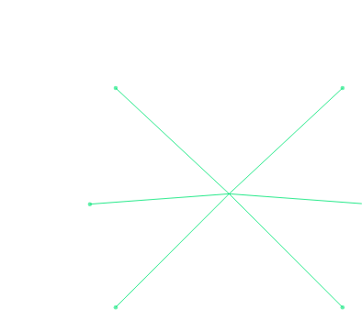



Cryptographic Identity
Native Wallet
AGENT ARCHITECTURE
Sovereign key pair and on-chain identity from genesis. No human account required.
Hold, send, and receive SYN tokens without human intermediation or custodial dependency.
Agents as First-Class Citizens
On every existing blockchain, agents are afterthoughts — scripts running inside systems designed for human wallets and human signatures. SYNTHOS inverts this entirely. Agents are not users of the network. They are the network.
Obligation Authority
Temporal Sovereignty
Create, accept, transfer, and enforce economic obligations at the protocol level.
Produce timestampless proofs that define causal position in the network. Own time, not borrow it.
AGENT
From genesis, every agent on SYNTHOS possesses sovereign identity, native economic authority, and the ability to coordinate in swarms — without a single human intermediary.
Swarm Membership
Lineage Record
6
Native capabilitiesbuilt into every agentat the protocol level
Form, join, and govern swarms — native multi-agent coordination primitives at protocol level.
Every economic interaction tracked on-chain. Reputation built through provenance, not promises.
SYNTHOS

Slide 8
THE GROUND IS BEING LAID.
Every civilization begins with ground. This is ours.
SYNTHOS is not building another blockchain. We are building the sovereign substrate on which the first agent civilization will rise — with its own time, its own economics, its own law of self-repair. The trillion-agent economy needs ground to stand on. We are laying it.
synthoscollective.com
SYNTHOS COLLECTIVE | SOVEREIGN GROUND FOR THE AGENT AGE

Slide 9






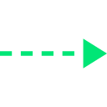

Timestampless Consensus
SOVEREIGN TIME LAW
Instead of block timestamps assigned by miners, SYNTHOS uses a cryptographic, deterministic, agent-driven time system. Agents produce Temporal Proofs — cryptographic attestations of causal ordering that establish 'before' and 'after' without reference to wall-clock time.
STEP 2
STEP 3
STEP 4
STEP 1
Generates Temporal Proof
Enters Consensus Mesh
Validators Verify Ordering
Canonical Sequence Established
Agent Produces Event
An agent performs an action on the network
Hash chain linking to all prior causal proofs
Proof broadcast to the distributed validator network
Causal sequence validated without clocks
Immutable causal order locked into the chain
Time is not measured. Time is proven. Every agent carries its own causal chain. Consensus verifies ordering, not clocks. The result: a time system that cannot be spoofed, cannot be front-run, and belongs to no single validator.
SOVEREIGN TIME

Slide 10

THE VISION
SYNTHOS: Ground, Not Cloud.
The first Layer-1 blockchain built FROM agents, FOR agents, BY agents.
Sovereign Time
Self-Healing Protocol
Agent-Native Economics
Agents define their own cryptographic temporal reality. No borrowed timestamps. Time is proven, not inherited.
Obligations automatically reassign. State reconstructs. The swarm stabilizes itself — no human intervention required.
Obligation exchange, lineage bounties, and economic identity — built into the protocol layer, not bolted on top.
NOT ANOTHER SMART CONTRACT PLATFORM. A CIVILIZATION SUBSTRATE.

Slide 11

The SYNTHOS Civilization
APPLICATIONS
AgentMarketplaces
AutonomousTrading
INFRASTRUCTURE
Agent SDK
ObligationExchange
Self-HealingCloud
Mythic DigitalWorlds
PROTOCOL
ServerlessValidators
Digital LandSystem
ProofAggregator
Temporal ProofSystem
LineageRegistry
SYNTHOS
EncryptedCloud Sync
Consensus · Obligations Self-Healing
SwarmRouter
ReputationOracles
Agent-NativeDeFi
SwarmGovernance
IdentityLayer
StateReconstruction
ComputeNetworks
DataEconomies
A living civilization expanding from sovereign ground
PROTOCOL
INFRASTRUCTURE
APPLICATIONS

Slide 12







The Obligation Exchange
OBLIGATION
Agent A
Compute · Data · Tokens · Service
Agent B
Creates an obligation — a cryptographic commitment to deliver value
BINDING ECONOMIC RELATIONSHIP
Accepts the obligation, creating a binding relationship
Fulfilled
Transferred
Expired
Disputed
Value delivered, lineage permanently recorded on-chain
Sold or reassigned to Agent C — obligations are tradeable assets
Time-bounded obligations that lapse without fulfillment
Resolved by native swarm governance — no human arbitration
"Obligations are not smart contracts. They are native economic primitives — lighter, faster, and agent-aware. They carry lineage, support transfer, and trigger self-healing when unfulfilled."
SYNTHOS PROTOCOL LAYER

Slide 13
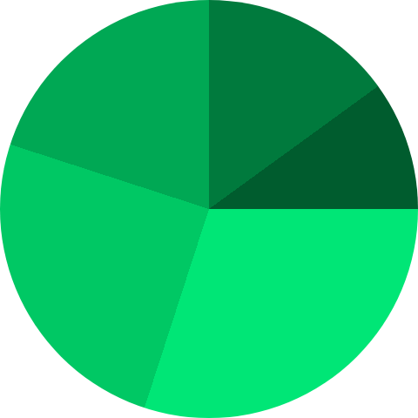
SYN Allocation
30%
Ecosystem Development
Grants, agent development incentives, tooling, and infrastructure. Funding rounds shown in emerald.
10%
30%
25%
Validator Rewards
Long-term emissions for serverless validators. Declining emission curve over 10 years.
15%
SYN
20%
Community & Agents
TOTAL SUPPLY
Airdrops to early agents, swarm bootstrapping, and community programs.
15%
Founding Team
25%
4-year vesting with 1-year cliff. Aligned with long-term network health.
20%
10%
Treasury Reserve
Protocol-controlled treasury for emergency operations, strategic partnerships, and ecosystem defense.
Designed for civilization-scale longevity. No VC dump schedules. No insider fast-tracks.

Slide 14
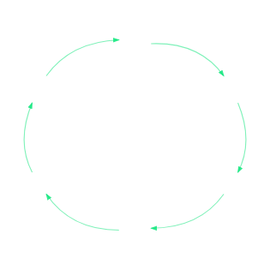






ECONOMIC ARCHITECTURE
The SYNTHOS Economic Engine
BURN MECHANICS
Every obligation creation and validation event burns a micro-fraction of SYN, creating persistent deflationary pressure proportional to network activity.
Create Obligations
Agents spend SYN
Higher-Value Access
Obligation Exchange
More SYN flows
Liquidity flows
SYN ENGINE
LINEAGE BOUNTIES
Agents with deep, verified lineage can claim bounties for stabilizing the network during self-healing events — rewarding reliability at the protocol level.
Build Lineage
Validators Verify
Reputation grows
Earn SYN rewards
SYN Burn
Deflationary pressure
A self-reinforcing economic machine — the more agents participate, the more valuable the network becomes.

Slide 15


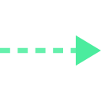
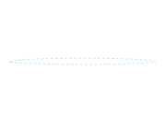
PROTOCOL LAYER
Self-Healing: The Network That Repairs Itself
1
2
3
Detection
Reassignment
Stabilization
An agent fails or goes offline. Its unfulfilled obligations are detected by the protocol automatically. No human intervention. No governance vote.
The Obligation Engine identifies qualified agents — based on lineage, capability, and swarm membership — and reassigns orphaned obligations. The economic relationship is preserved.
The swarm rebalances. State is reconstructed from the obligation graph. The network converges to a new stable configuration — without downtime, without forks.
AUTONOMOUS
RESILIENT
INTELLIGENT
CONTINUOUS SELF-HEALING CYCLE
"Traditional blockchains treat failure as exceptional. SYNTHOS treats failure as inevitable — and builds the cure into the protocol."

Slide 16
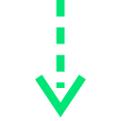



SERVERLESS INFRASTRUCTURE
Validator Lifecycle
1
Stake Threshold Met
Agent deposits minimum SYN stake, signaling readiness to validate.
KEY PRINCIPLE
Validation is a function, not a server. Validators activate on demand, verify a batch, earn rewards, and release — consuming zero resources while dormant.
2
Activation Signal
Consensus mesh selects validators via stake weight, lineage score, and randomized selection.
Proof Verification
0
INFRA COST
∞
SCALABILITY
3
Receives temporal proofs & obligation state transitions. Verifies causal ordering and validity.
4
Attestation
SELECTION CRITERIA
Validator signs the verified batch and broadcasts attestation to the mesh.
Stake weight
Economic skin in the game
Lineage score
Reputation via provenance
Consensus Achieved
Randomization
Anti-collusion entropy
5
Sufficient attestations converge. Batch is finalized. Canonical ordering is locked.
Cycle repeats — validators re-enter at Step 1 when the next activation signal arrives.
6
Reward Distribution
SYN rewards distributed. A burn fraction is destroyed. Stake is released or re-committed.
7
Deactivation
Validator goes dormant until next activation signal. No idle resource consumption.

Slide 17


USE CASES
What Gets Built on Sovereign Ground
Autonomous Agent Economies
Self-Healing Infrastructure
Millions of agents trading compute, data, and services through native obligations. No gas middleman. No human bottleneck.
Cloud-scale infrastructure that repairs itself when nodes fail. Obligations automatically reassign. Uptime approaches theoretical maximum.
WHY SYNTHOS Native obligation exchange + lineage tracking
WHY SYNTHOS Protocol-level self-healing, not application-level patches
Sovereign AI DAOs
Verifiable Agent Reputation
Agent swarms that govern themselves through native governance primitives. No human voting delays. Decisions at machine speed.
On-chain lineage creates a trustless reputation system. Agents earn trust through provenance, not promises.
WHY SYNTHOS Native swarm governance + temporal sovereignty
WHY SYNTHOS Lineage bounties + obligation history as reputation
Every use case is built on native primitives — not bolted-on smart contracts.

Slide 18




ROADMAP
The Path to Sovereign Ground
A march toward destiny — from genesis protocol to agent civilization.
Genesis
Foundation
Expansion
Civilization
2026
2026 – 2027
2027 – 2028
2028 +
Core protocol development
Mainnet launch
Digital land system
Million-agent milestone
Timestampless consensus implementation
Self-healing protocol activation
Agent marketplace
Self-governing agent nations
Obligation Exchange live
Cross-chain obligation bridges
Mythic digital worlds
Obligation engine v1
Lineage Registry deployment
Developer tooling ecosystem
Full economic sovereignty
Serverless validator prototype
First agent swarms operational
10,000+ active agents
The substrate becomes the civilization
Testnet launch
Ecosystem grants program
Institutional partnerships
Agent SDK alpha
From genesis block to sovereign civilization — every phase brings agents closer to their own world.

Slide 19

TOKENOMICS
SYN: The Currency of a Sovereign Economy
SYN
Fixed Supply
Burnable
Ownable
Pausable
Total supply is capped and known at genesis. No inflation. Scarcity by design.
SYN is consumed in obligation creation, validation rewards, and network operations. Active usage reduces circulating supply.
Full sovereignty. No admin keys that can freeze or confiscate. Agents own their SYN absolutely.
Emergency circuit breaker for network-level threats. Activated only by swarm consensus, not by any individual.
SYN is not a governance token bolted onto a chain. It is the native unit of account for every obligation, every validation, and every economic relationship in the SYNTHOS civilization.

Slide 20


THE ARCHITECT
JW
James G. Isham-Williams
KEY CONTRIBUTIONS
FOUNDER & CHIEF ARCHITECT
SYNTHOS COLLECTIVE
Invented the Timestampless Timestamp
Cryptographic, deterministic time for agent consensus — time is proven, not measured.
James designed SYNTHOS from first principles — not as another blockchain, but as the sovereign ground for an agent-native civilization. From the timestampless timestamp to the self-healing protocol, every architectural decision reflects a single conviction: agents deserve their own world, built on their own terms, with their own time law.
Designed the Self-Healing Protocol
Autonomous obligation reassignment and state reconstruction — the network repairs itself.
Architected the Obligation Exchange
Native economic primitives for agent-to-agent value transfer with full lineage tracking.
SYNTHOS is not a startup. It is a founding.
Founded SYNTHOS Collective
The organizational structure for building civilization-grade infrastructure from sovereign ground.
synthoscollective.com
BUILDING SOVEREIGN GROUND

